Slide 1
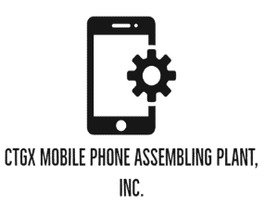
Innovation & Entrepreneurship Activities
Business Plan

Slide 2
Welcome!
Thanks for joining us
Group 2
Iqbal Aqsa_2019380162
Abid Ali_2019380141
Mahmud Abrar Al­_2019380188

Slide 3
Todays discussing Points:
01
Executive Summary
04
Operations plan
02
The Economics of CTGx
05
Our Business Structure
03
Startup Expenditure
06
MARKET ANALYSIS

Slide 4
Todays discussing Points:
07
Our Target Market
10
Sustainability and Expansion Strategy
08
Our competitive advantage
11
Financial projection of CTGx
09
SALES AND MARKETING STRATEGY

Slide 5
Executive Summary
CTGx Mobile Phone Assembling Plant, Inc. is a registered mobile phone assembling plant company that will be located in will in Gazipur – Bangladesh. We have been able to secure all the license and permits required and also a world class facility in a good location in Gazipur.
CTGx Mobile Phone Assembling Plant, Inc. is located in a full-service automated mobile phone assembling plant. We will be involved in the assembling of mobile phones (Android smart phones) for-smartphone manufacturing companies who are looking for partners in Bangladesh. We want to assemble phones that will be used in Bangladesh.

Slide 6
Executive Summary(Cont.)
We are quite optimistic that our values and quality of products will help us drive our mobile phone assembling plant business to enviable heights and also help us attract the number of clients that will make the business profitable.
We are quite aware that in order to get people and organizations to purchase and make use of the mobile phone brands that we assembled in our plant, we must continue to assemble quality mobile phones. We are open to the use of latest technology in our mobile phone assembling plant. Our excellent customer service and the quality of the mobile phones we assemble will position us to always welcome repeated customers.
Our client’s best interest will always come first, and everything we do will be guided by our values and professional ethics. We will ensure that we hold ourselves accountable to the highest standards by meeting our client’s needs precisely and completely.

Slide 7
The Economics of CTGx
The main revenue driver of company is selling smartphones in a B2B market. Our net profit margin would be roughly 27% where variable cost per unit is $350.00 and fixed cost for the whole plant including machinery rent and salary is $150,000.
First year we will release one midrange model X1 and one flagship phone model X2, whose estimated market price would be $500 and $650 respectively. we will give our cell phones to the retailers on 89% of the market price.
CTGx ’s average revenue per smartphone will be $512.
Expected smartphone sales first year is 8000 units.
Total Revenue: $4096000
Total Costs: $2950000
Net Profit: $1146000
Break Even Units: 926

Slide 8
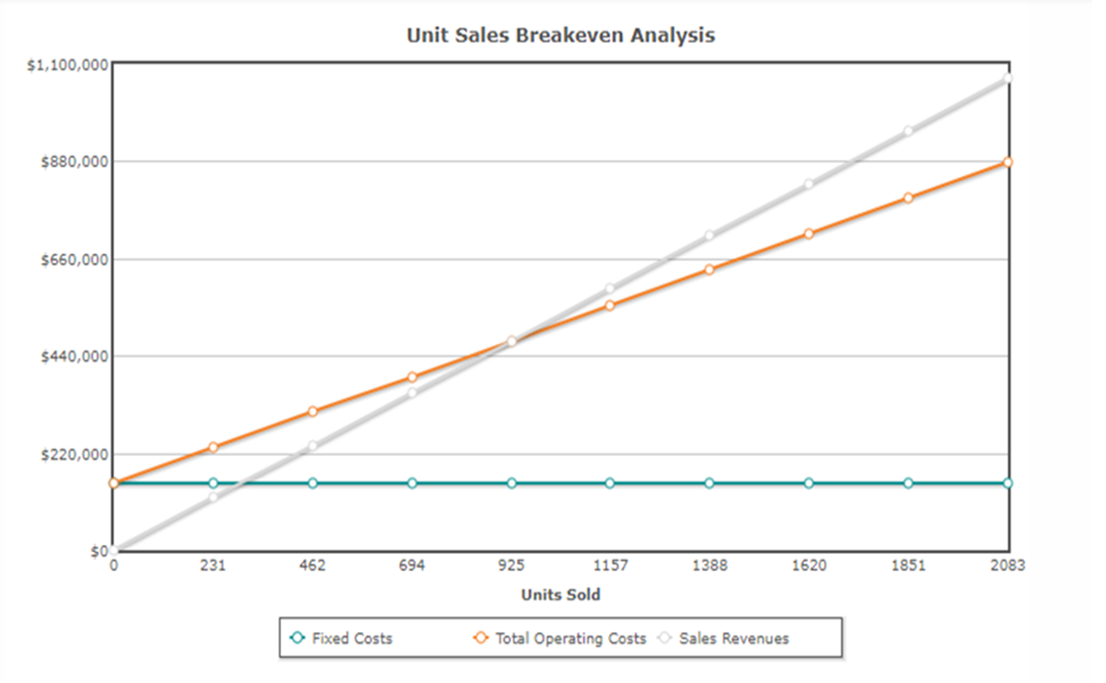

Slide 9
Startup Expenditure (Budget)
We have been able to pull cash that will be enough for us to successfully launch a standard mobile phone assembling plant company in Gazipur economic zone, Bangladesh. These are the key areas where we will spend our startup capital on.
The Total Fee for Registering the Business in the Bangladesh- $3990
Legal expenses for obtaining licenses and permits – $100.
Marketing promotion expenses (2,000 flyers at $0.04 per copy) for the total amount of $13,580.
The cost for hiring Business Consultant – $5,000.
Insurance (general liability, workers’ compensation, and property casualty) coverage at a total premium – $30,800.
The cost of accounting software, CRM software and Payroll Software – $50,000
The total cost for leasing standard plant facility- $300,000.
The total cost for facility remodeling – $200,000.
Other start-up expenses including stationery – $1000
P.T.O

Slide 10
Startup Expenditure (Budget)…
The amount needed for phone and utility deposits – $3,500
Operational cost for the first 3 months (salaries of employees, payments of bills et al) – $400,000
The cost for Start-up inventory – $150,000
The cost for store equipment (cash register, security, ventilation, signage) – $13,750
The cost for the purchase of furniture and gadgets (Computers, Printers, Telephone, TVs, Credit card machine, POS, tables, and chairs et al) – $4,000.
The cost of Launching a website – $600
Miscellaneous: $100,000
We would need an estimate of one million five hundred thousand US dollars ($1.5 million) are approximately Bangladeshi taka 75,500,000 to successfully launch our mobile phone assembling plant in the municipal area, economic zone, Chittagong, Bangladesh.

Slide 11
Generating Startup Capital for CTGx Mobile Phone Assembling Plant, Inc.
These are the areas we intend generating our startup capital.
Generate part of the startup capital from personal savings and sale of his stocks
Generate part of the startup capital from friends and other extended family members
Generate a larger chunk of the startup capital from the bank (loan facility).
N.B: We have been able to generate about $500,000 (Personal savings $400,000 and soft loan from family members $100,000) and we are at the final stages of obtaining a loan facility of $1 million from our bank. All the papers and documents have been duly signed and submitted, the loan has been approved and any moment from now our account will be credited.

Slide 12
Operations plan
We want to build a mobile phone assembling plant that will help some of the mobile phones manufacturing giants in assembling their mobile devices.
Our mission as a mobile phone assembling plant is to develop a highly successful mobile phone assembling plant that can assemble durable and affordable mobile phones that will be retailed in Bangladesh; we want to be listed amongst the top mobile phone assembling plants in the country.

Slide 13

Use a map for infographics, statistics or to visualize locations
Bangladesh,Gazipur.

Slide 14
Location
When planning to start a mobile phone assembling business, a key factor to consider would be location. There are some fantastic locations in nearby Dhaka and Chittagong. We prefer to choose Gazipur, Dhaka for several reasons as follows:
Gazipur is a now the industrial hub of Dhaka, Bangladesh. It has become special economic zones along with the export-oriented garments industry. Top garments are situated here because of the facilities provided by the government. Besides, the labors live here because of cheap transportation and housing facility. Gazipur is a city in central Bangladesh. It is located in the Gazipur District. It is a major industrial city located 25 km north of Dhaka. With the construction of Kaliakoir hi-tech park underway, it will be considered as a special economic zone (SEZ) to attract foreign and local investors where they could utilize vast potential of young educated and technically skilled work force. Eventually country’s economy will be substantially augmented by increasing foreign exchange. The total cost of the project now stands at Tk 2.2 billion.

Slide 15
Reason for choosing the location
Water
City Region Development Project for Water Supply and Sanitation in Gazipur is responsible for ensuring consistent water supply in industrial areas.
Power
Bangladesh now has a power generation capacity in excess of 21,000 MW
Hire Employees for Technical and Manpower Needs
It’s very important to state that this business requires adequate funding because we need funds to get quality equipment, rent or build a plant, pay employees.
These personnel include Chief Executive Officer (CEO), admin and human resources manager, accountant, business development and marketing executive, assembly line workers, customer service
All of these resources are available in Gazipur

Slide 16
Our Business Structure
We are aware that the success of any business lies in the foundation on which the business is built on, which is why we have decided to build our mobile phone assembling plant company on the right business foundation.
We want to build a dedicated workforce that will ensure that our customers are satisfied when they purchase mobile phones that are assembled in our plant.
We are aware that it takes a business with the right employees and structure to achieve all what we have set to achieve, which is why will be putting structures and processes in place that will help us assemble durable mobile phones and run the business on auto pilot.
With the nature of the mobile phone assembling business, we are only expected to employ adequate number of employees. CTGx Mobile Phone Assembling Plant, Inc. will employ professionals and skilled people to occupy the following position

Slide 17
Our Business Structure(Cont.)
Chief Executive Officer
Plant Manager
Human Resources and Amin Manager
Sales and Marketing Manager
Mobile Phone Assembling Engineers/Technicians
Accountants/Cashiers
Customer Services Executive/Front Desk Officer

Slide 18
MARKET ANALYSIS
People involved with the mobile phone sector feel Bangladesh will no longer need to import handsets as a dozen of local factories are scaling up assembly operations. The factories are fully capable to meet the local smart phone demand, while they can supply almost 80 percent of the feature phones.
Top officials of the plants, including that of Korean giant Samsung Electronics, say the sector will be able to fully meet the local demand this year. The production of mobile phone handsets in Bangladesh has caused the grey market of illegal and fake mobile to shrink.
As many as 33 million mobile handsets were made in Bangladesh over the past one and a half years, including 18.8 million in last six months.
The handset market in Bangladesh is worth over Tk 100 billion or roughly $1.2 billion.

Slide 19
MARKET ANALYSIS(Cont.)
The annual demand in Bangladesh is more than 35 million handsets, including 11 million smart phones made or assembled locally. Over 60 percent of the feature phones are made or assembled in Bangladesh. The plants will be able to meet the demand fully in a short time.
The market of illegally brought and fake handsets will be gone when the regulator begins the process to shut down such phones. More companies are now keen on setting up factories in Bangladesh and the association is providing assistance to those firms.
The government is prepared to fully support these companies.

Slide 20
FUTURE PLAN
Our preliminary target will be to capture the local market which is still wide open. In our next phase we will set up as a total manufacturing unit at the EPZ, where much more facilities are provided by the government. It will be a total export oriented.
OUR COMPETITORS
We have to keep in mind that to survive we have to fight hard with company like Samsung, Vivo, Oppo, Walton and others. As per Darwin’s theory “survival of the fittest”.

Slide 21
Market Trends
Bangladeshis, especially the middle class make use of mobile phones that are assembled in Bangladesh. This goes to show that there is a thriving business for mobile phone assembling plants in Bangladesh.
In recent time, it is trendier to find mobile phone manufacturing giants especially from Asia and Europe establishing their assembling plants or contracting the assembling of their mobile phones to a standard independent mobile phone assembling plant.
Another notable trend in the mobile phone manufacturing industry is in order to stay ahead of your competitors, you must continue to come up with smartphones that are sleek, durable and comes with unique features amongst others. Please note that mobile phone assembling plant business responds to increase in household spending and also increase in the earning powers of people. The trend of the market can be predicted without stress.
Artificial intelligence (AI) ----. Artificial intelligence has penetrated our mobile world.
Location-based technology ---- smart phones and tablets are tracking your location. That’s not a secret
Augmented reality ----- Augmented reality takes something that’s real and modifies it.
Syncing wearable technology with mobile devices ---- Wearable technology has become increasingly popular.
Revenue from mobile applications ---- Mobile apps are making a killing. Just look at the jump from 2016 to 2017 in terms of global app revenue
Mobile devices syncing with homes------ Mobile apps are being developed to help improve consumers’ experiences within their own homes.
Enhanced mobile security------ Saying that security is important would be an understatement.
Small business mobile apps ------- Not long ago, mobile applications were just for the big players. But now everyone is developing them.
Increased mobile payments ---- As mobile security improves and global app revenue rises, we’ll see an increase in mobile payments as well.
Transportation apps ---- For quite some time, we’ve seen apps for train tickets, local bus schedules, etc

Slide 22

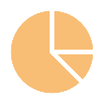



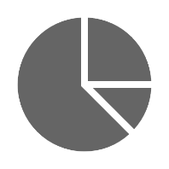




Market Trends in 2021
Messaging
Data analysis
Cloud computing
Shopping
.

Slide 23
Our Target Market
The target market for this line of business is in two phases; they are mobile phones manufacturing companies who want to contract the assembling of their mobile phones to a third – party company and of course those who purchase and make use of mobile phones.
Those who purchase mobile phones cut across all male and female above 18 years with the financial means hence the target market for mobile phones assembling plant business is all encompassing.
In view of that, we have positioned our mobile phone assembling plant to service the residents of every city where our mobile phones will be sold. We have conducted our market research and feasibility studies and we have ideas of what our target market would be expecting from us.

Slide 24
Our competitive advantage
Mobile phone assembling plant business is a highly creative industry. We are aware of this which is why we decided to come up with a business concept that will position us to work for mobile phones manufacturing giants.
Our competitive edge is that we are standard mobile phone assembling plant that can boast of having some of the finest smartphones engineers and technicians. We will ensure that only durable and efficient mobile phones are rolled out from our assembling plant.
We can confidently say that the location of our mobile phone assembling plant will definitely count as a positive for us.
Lastly, all our employees will be well taken care of, and their welfare package will be among the best within our category in the industry. It will enable them to be more than willing to build the business with us and help deliver our set goals and achieve all our business aims and objectives.

Slide 25
SALES AND MARKETING STRATEGY
Sources of Income
CTGx Mobile Phone Assembling Plant, Inc. is established with the aim of maximizing profits in the mobile phone assembling business and we are going to ensure that we do all it takes to attract and retain all our clients. CTGx Mobile Phone Assembling Plant, Inc. will generate income by assembling mobile phones that will be used by a wide range of clientele in Bangladesh.
Sales Forecast
We have been able to examine the mobile phone assembling plant market, we have analyzed our chances in the industry, and we have been able to come up with the following sales forecast.
Below are the sales projection for CTGx Mobile Phone Assembling Plant, Inc., it is based on the location of our business and of course the wide range of mobile phones that we will be rolling out from our mobile phone assembling plant.
First Year: $1 Million
Second Year: $2.3 Million
Third Year: $4.8 Million

Slide 26
Projected Year | Projected Money
First Year: | $1 Million
Second Year: | $2.3 Million
Third Year: | $4.8 Million
N.B: This projection was done based on what is obtainable in the mobile phone assembling plant line of business and with the assumption that there won’t be any major economic meltdown and there won’t be any major competitor within same location. Please note that the above projection might be lower and at the same time it might be higher.

Slide 27
Marketing Strategy and Sales Strategy
The marketing strategy for CTGx Mobile Phone Assembling Plant, Inc. is going to be driven basically by solid mobile phones, excellent customer service, honesty, and efficiency. We want to drive sales via the output of our brands and via referral from our satisfied customers. We are quite aware of how satisfied customers drive business growth especially businesses like mobile phone assembling plant.
CTGx Mobile Phone Assembling Plant, Inc. is strategically located, and we are going to maximize the opportunities that is available which is why we spent more to locate the business where it can be visible and enable us to access our target market.
Our sales and marketing team will be recruited based on their vast experience in the industry, and they will be trained on a regular basis so as to be to meet their targets. CTGx Mobile Phone Assembling Plant, Inc. is set to make use of the following marketing and sales strategies to attract clients.

Slide 28
Marketing Strategy and Sales Strategy (Cont.)
Ideas that we will implement for Advertising:
Introduce our mobile phone assembling plant business by sending introductory letters alongside our brochure to mobile phone manufacturing companies and key stake holders w the country.
Advertise our mobile phone assembling plant company in relevant phone magazines, newspapers, TV, and radio stations.
Attend relevant expos, seminars, and mobile phone technology business fairs to market our mobile phone brands
Engage in direct marketing approach

Slide 29
Marketing Strategy and Sales Strategy (Cont.)
Ideas that we will implement for Advertising:
Introduce our mobile phone assembling plant business by sending introductory letters alongside our brochure to mobile phone manufacturing companies and key stake holders w the country.
Advertise our mobile phone assembling plant company in relevant phone magazines, newspapers, TV, and radio stations.
Attend relevant expos, seminars, and mobile phone technology business fairs to market our mobile phone brands
Engage in direct marketing approach
Our Pricing Strategy
Our pricing system is going to be based on what is obtainable in the mobile phone assembling plant line of business, we don’t intend to sell our mobile phones or charge our clients more and we don’t intend to sell less than our competitors are selling. The prices of our mobile phones will be same as what is obtainable in the open market.

Slide 30
Sustainability and Expansion Strategy
The future of a business lies in the number of loyal customers that they have, the capacity and competence of their employees, their investment strategy, and the business structure. If all of these factors are missing from a business, then it won’t be too long before the business closes shop.
One of our major goals of starting CTGx Mobile Phone Assembling Plant, Inc. is to build a business that will survive off its own cash flow without injecting finance from external sources once the business is officially running. We know that one of the ways of gaining approval and winning customers over is to ensure that we roll out highly competitive mobile phones from our mobile phone assembling plants.
We will make sure that the right foundation, structures, and processes are put in place to ensure that our staff welfare are well taken of. Our company’s corporate culture is designed to drive our business to greater heights and training and retraining of our workforce is at the top burner.
We know that if that is put in place, we will be able to successfully hire and retain the best hands we can get in the industry; they will be more committed to help us build the business of our dreams.

Slide 31
Net Revenue |  | #########
AR (% of revenue) |  | 10%
AP |  | 8%
Deferred Rev |  | 3%
INVENTORY |  | 13%
DEPOSITS & PREPAYMENTS |  | 3%
MISC. |  | 9%
Debt Payments |  | $ 600,000
Interest Rate |  | 8%
Interest Payments |  | $ 32,000
 | Year 1 | Year 2
Revenue
Customers | 8,000 | 12,000 | 24,000
AOV | $ 512 | $ 512 | $ 512
V.C (PER UNIT) | 350 | 350 | 350
COGS
Product | 35% | 35% | 35%
Fulfillment | 5% | 5% | 5%
Merchant Services | 3% | 3% | 3%
Operating Expenses
Personnel | 20% | 20% | 20%
Marketing | 10% | 10% | 10%
Other | 5% | 5% | 5%
Tax Rate | 17% | 17% | 17%
Assumption Sheet

Slide 32
Pro forma balance sheet
Balance Sheet | Dec 31, Year 0 | Year 1
 | Historical
ASSETS
Cash | $ 40,000 | $ (572,605)
Accounts Receivable | $ 393,260 | 114,600
INVENTORY | $ 150,000 | $ 148,980
DEPOSITS & PREPAYMENTS | $ 34,300 | $ 34,380
Computer | $ 495,700 | $ 103,140
Total Current Assets | 1,113,260 | (171,505)
Fixed Assets | $ 532,440 | 1,458,380
Accumulated Depreciation | $ (10,000) | (116,563)
Net Fixed Assets | 522,440 | 1,341,817
Total Assets | 1,635,700 | 1,170,312
LIABILITIES
Accounts Payable | $ 35,700 | 91,680
Deferred Revenue | $ 50,000 | 34,380
Total Current Liabilities | 85,700 | 126,060
Long Term Debt | $ 1,000,000 | $ 400,000
Total Liabilities | 1,085,700 | 526,060
EQUITY
Common Stock | $ 500,000 | $ 500,000
Retained Earnings | $ 50,000 | $ 144,252
Total Shareholders’ Equity | 550,000 | $ 644,252
Liabilities & Shareholders’ Equity | 1,635,700 | 1,170,312
Balance Check | - | -

Slide 33
Pro forma income statement
Income Statement | Year 1 | Year 2 | Year 3
Revenue
Gross Revenue | $ 4,096,000 | $ 6,144,000 | $ 12,288,000
VARIABLE COST | (2,800,000) | (4,200,000) | (8,400,000)
FIXED COST | (150,000) | (150,000) | (150,000)
Net Revenue | $ 1,146,000 | $ 1,794,000 | $ 3,738,000
Cost of Goods Sold
Product | $ 401,100 | $ 627,900 | $ 1,308,300
Fulfillment | 57,300 | 89,700 | 186,900
Merchant Services | 34,380 | 53,820 | 112,140
Total COGS | $ 492,780 | $ 771,420 | $ 1,607,340
Gross Margin | $ 653,220 | $ 1,022,580 | $ 2,130,660
GM % | 57% | 57% | 57%
Operating Expenses
Personnel | $ 229,200 | $ 358,800 | $ 747,600
Marketing | 114,600 | 179,400 | 373,800
Other | 57,300 | 89,700 | 186,900
Depreciation | 106,563 | 6,787 | 10,120
Total OPEX | $ 507,663 | $ 634,687 | $ 1,318,420
Operating Income | $ 145,557 | $ 387,893 | $ 812,240
Interest | $ 32,000 | $ 80,000 | $ 8,000
NI Before Taxes | $ 113,557 | $ 307,893 | $ 804,240
Taxes | $ 19,305 | $ 52,342 | $ 136,721
Net Income | $ 94,252 | $ 255,551 | $ 667,519
NI % | 8% | 14% | 18%
EBITDA | $ 252,120 | $ 394,680 | $ 822,360

Slide 34
Pro forma cash flow
___
Cash Flow Statement | Year 1 | Year 2 | Year 3
Net Income | $ 94,252 | $ 255,551 | $ 667,519
Operating Activities
Depreciation | 106,563 | 6,787 | 10,120
Chg. in AR | 78,660 | 24,900 | (97,200)
Chg. in AP | (108,320) | 15,960 | 116,640
Chg. in Def Rev | (15,620) | 55,320 | 209,340
Operating Cash Flow | $ 155,535 | $ 358,518 | $ 906,419
Investing Activities
Capex | 532,440 | 10,000 | 10,000
Free Cash Flow | $ (376,905) | $ 348,518 | $ 896,419
Financing Activities
Debt Repayment | (600,000) | (900,000) | (900,000)
Net Borrowings | - | 1,500,000 | -
NCF from Financing | (600,000) | 600,000 | (900,000)
Net Cash Flow | $ (976,905) | $ 948,518 | $ (3,581)

Slide 35
Thank You!
Any questions?

